Slide 1
Dynamodb vs Other Db
Anju munoth

Slide 2
Azure Cosmos DB
Azure Cosmos DB is a fully managed, elastically scalable, and globally distributed database with a multi-model approach. It offers plenty of benefits and provides you the ability to use document, key-value, wide-column, or graph-based data.
Cosmos DB is another highly available, horizontally scalable NoSQL database service.
It is offered by Azure and is known as a multi-model database service.
It enables customers to instantly develop and distribute their apps across Azure data centers without any prior configuration.
In addition, it is available in all Azure regions and replicates its data across multiple data centers in the network because it is part of Azure.

Slide 3
Azure Cosmos DB API
five different APIs available in Azure Cosmos DB:
Core (SQL) API: Provides the flexibility of a NoSQL document store combined with the power of SQL for querying.
MongoDB API: Supports the MongoDB wire protocol so that existing MongoDB client continue to work with Azure Cosmos DB as if they are running against an actual MongoDB database.
Cassandra API: Supports the Cassandra wire protocol so that existing Apache drivers compliant with CQLv4 continue to work with Azure Cosmos DB as if they are running against an actual Cassandra database.
Gremlin API: Supports graph data with Apache TinkerPop (a graph computing framework) and the Gremlin query language.
Table API: Provides premium capabilities for applications written for Azure Table storage.

Slide 4
Common scenarios for using Azure Cosmos DB
Modern gaming services need to deliver customized and personalized content like in-game stats, social media integration, and high-score leaderboards. As a fully managed offering, Azure Cosmos DB requires minimal setup and management to allow for rapid iteration, and reduced time to market.
E-commerce platforms and retail applications store catalog data and for event sourcing in order processing pipelines.
Applications that provide personalized experiences can be quiet complex. They need to be able to retrieve user specific settings effectively to render UI elements and experiences quickly

Slide 5
Azure Cosmos DB API
Although the Core (SQL) is quite versatile and applicable to a wide range of scenarios, if your data is better represented in terms of relationships, then the Gremlin (graph) API is a suitable choice.
In case you have existing applications using Cassandra or MongoDB, then migrating them to the respective Azure Cosmos DB APIs provides a path of least resistance with added benefits.
In case you want to migrate from Azure Table Storage and do not want to refactor your application to use the Core (SQL) API, remember that you have the option of choosing the Azure Cosmos DB Table API, that can provide API compatibility with Table Storage as well as capabilities such as guaranteed high availability, automatic secondary indexing and much more!

Slide 6
Shared Attributes for DynamoDB and Cosmos DB
Both DynamoDB and Cosmos DB allow you to create highly available, reliable, and scalable serverless NoSQL databases.
Both provide fully managed services and make it easier for the developer to configure the database and proceed with their applications with minimal intervention.
On the other hand, DynamoDB models data as key-value and documents, whereas Cosmos DB models data as key-value, documents, graphs DBMS, and in wide column stores.
Also, Cosmos DB is designed to be a drop-in replacement for a typical relational database that supports SQL queries, whereas DynamoDB doesn't support ANSI SQL.

Slide 7
Dynamodb
Cosmos DB
High-performance database service, and it can handle more than 10 trillion requests per day and 20 million requests per second at its peak.
Utilizes the high IO rates of the SSDs to minimize the latency and reaction time when reading and writing data.
Can use DynamoDB Accelerator to improve the read and write performance by ten folds.
Regardless of the table size, DynamoDB ensures high performance and maintains the latency within the millisecond range.
Can further improve these numbers with efficient indexes and partitioning.
Ensures 99% availability for reading and wiring data with the facility to replicate across multiple regions.
Ensures low latencies for both read and write operations.
Usually, the read latency is below 10 milliseconds, and the write latency is below 15 seconds.
World's first globally distributed database service, with comprehensive service level agreements (SLAs) for throughput, latency, availability, and consistency.
Similar to DynamoDB, Cosmos DB also has an SSD-backed storage system with low-latency order-of-millisecond response times.
Supports 5 consistency levels
Reserved throughput model in Cosmos DB allows you to think about reads/writes rather than CPU/memory/IOPs of the underlying hardware.

Slide 8
Security
DynamoDB
One of the primary reasons people prefer AWS for their databases is its high security.
DynamoDB support user-based authentication through AWS IAM and encryption at rest using AWS KMS.
Encryption at Rest: All user data stored in tables, indexes, streams, and backups are encrypted at rest by DynamoDB using encryption keys stored in AWS Key Management Service (AWS KMS).
This adds an extra layer of data security by preventing unauthorized access to the underlying storage.
IAM user roles authentication: You can create separate users, user roles, and policies using AWS IAM and assign them to uses based on the requirements. With proper configurations, you can easily allow different users to access different tables.
Cosmos DB
Cosmos DB adheres to a hash-based message authentication for authorization purposes of the applications and uses SSL/TLS enforcement for client-service interactions.
Apart from that, Cosmos DB uses encryption at rest for all data stored. Nothing needs to be configured, and you have the same latency, throughput, availability, and functionality as before, with an additional assurance that your data is safe and secure.

Slide 9
Backups
DynamoDB
DynamoDB has 2 backup options: on-demand backups and PITR (Point-in-Time Recovery).
On-demand backup - Allows you to create full backups of your tables for long-term storage and archiving for regulatory compliance purposes. Table performance and availability are unaffected by backup and restore operations.
Point-in-time - PITR safeguards your DynamoDB tables against unintentional writes or deletes operations. When enabled, point-in-time backups will be created automatically, and it allows you to restore tables up to any point in the last 35 days with a precision of seconds.
Cosmos DB
Cosmos DB also has 2 backup modes,
Continuous backup mode - The continuous backup mode can restore your data to any point within the last 30 days. It backups data in the background, consuming no additional provisioned throughput and having no effect on the performance or availability of your database.
Periodic backup mode. -The periodic backup mode is the default backup mode for Cosmos DB. Backups are taken at regular intervals, and data can be restored by submitting a request to the support team.

Slide 10
Use-Cases
Service | Use-Cases
AWS DynamoDB | Ad Tech, Gaming, Retail, Banking and Finance, Media and entertainment, Software and internet
GCP Bigtable | Financial Analysis, IoT, Ad Tech
GCP Firestore in Datastore Mode | Application developers that need a highly scalable, easy-to-use NoSQL document database
Azure Cosmos DB | Mission-critical applications, Hybrid Cassandra workloads, Near Real-time Analytics, Real-time IoT device telemetry, Real-time retail services

Slide 11
Schema, Data and Queries
Service | Data-model | Supported data types
AWS DynamoDB | Key-value, Document | Scalar: number, string, binary, Boolean, null Document: list, map Set: string set, number set, binary set
GCP Bigtable | Wide column store | All data generally treated as raw byte strings
Azure Cosmos DB | Key-value, Document, Graph, Column | Whatever can be serialized as valid JSON

Slide 12
Pricing and Service Limits
Primary billing units for AWS are “Write request units” and “Read request units”, representing a request to either write or read data from a DynamoDB table.
AWS also charges for additional features, such as backups, global replication, streaming, and network egress.
An egress only internet gateway is used to enable outbound communication over IPv6 from instances in your VPC to the internet, and prevents hosts outside of your VPC from initiating an IPv6 connection with your instance.

Slide 13
Azure Cosmos DB provides two billing models for customers to choose from: Provisioned Throughput and Serverless.
Provisioned Throughput measures usage in request units per second, and bills per hour. Customers can pre-pay for provisioned capacity on annual and multi-year terms as well. In addition, storage and network egress are billed.
In the serverless model, customers only pay for incurred usage, which will be more appropriate for workloads that are not consistent and bursty.

Slide 14
Service* | Billing Units | Cost**
Writes(Provisioned)***
AWS DynamoDB | Write Capacity Unit(WCU) | 25 WCUs/month free, $0.00065 per WCU/hour
GCP Bigtable | Node hour | $0.65/hour per node, usage subject to quotas/limits
Azure Cosmos DB – Single-region write account | Request Units(RU) | 400 RU/s/month free Autoscale: 100 RU/s x 1.5 x 1 region – $0.008/hour Manual: 100 RU/s x 1 region – $0.008/hour

Slide 15
Service* | Billing Units | Cost**
Writes(On-Demand)***
AWS DynamoDB | Write Request Unit | $1.25/1 million write request units
GCP Firestore in Datastore Mode | Entity Writes/Document Writes | 20000 entity writes/day free, $0.099 per 100,000 documents
Azure Cosmos DB – Serverless | Request Units(RU) | $0.25/1 million RUs

Slide 16
Service* | Billing Units | Cost**
Reads(Provisioned)***
AWS DynamoDB | Read Capacity Unit(RCU) | 25 RCUs/month free,$0.00013 per RCU/hr
GCP Bigtable | Node hour | $0.65/hr per node, usage subject to quotas/limits
Azure Cosmos DB – Single-region write account | Request Units(RU) | 400 RU/s/month free Autoscale: 100 RU/s x 1.5 x 1 region – $0.008/hour Manual: 100 RU/s x 1 region – $0.008/hour

Slide 17
Service* | Billing Units | Cost**
Reads(On-Demand)***
DynamoDB | Read Request Unit | $0.25/1 million read request units
GCP Firestore in Datastore Mode | Node hour | $0.65/hour per node, usage subject to quotas/limits
Azure Cosmos DB – Serverless | Request Units(RU) | $0.25/1 million RUs

Slide 18
Service* | Billing Units | Cost**
Backups***
AWS DynamoDB | Gigabyte(GB) | Continuous backup(PITR): $0.20 per GB/month On-demand backup:$0.10 per GB/month Restore: $0.15/GB
GCP Bigtable | Gigabyte(GB) | $0.029 per GB/month
Azure Cosmos DB | Gigabyte(GB) | Periodic backup: 2 copies free, >2 copies $0.12/GB per copy Continuous backup: $0.20/GB x regions Point-in-time restore: $0.15/GB

Slide 19
Service* | Billing Units | Cost**
Storage
AWS DynamoDB | Gigabyte(GB) | 25GB/mo free, $0.25 per GB/month
GCP Bigtable GCP Firestore in Datastore Mode | Gigabyte(GB) | SSD storage: $0.19 per GB/month HDD storage: $0.029 per GB/month $0.099 per GB/mo
Azure Cosmos DB | Gigabyte(GB) | Transactional storage (row-oriented): $0.25 per GB/month Analytical storage (column-oriented): $0.03 per GB/month

Slide 20
Service* | Billing Units | Cost**
Replication(Provisioned)
AWS DynamoDB | Replicated write capacity unit (rWCU) | $0.000975 per rWCU/hour
GCP Bigtable | Gigabyte(GB) | Subject to Internet Egress Rates
Azure Cosmos DB | Request Units(RU) | Autoscale: Single-region write account with data distributed across multiple regions (with or without availability zones): 100 RU/second x 1.5 x N regions – $0.008/hour Multi-region write $0.016/hour Standard: Single-region write account distributed across N regions (excluding availability zones): 100 RU/s x N regions – $0.008/hour Single-region write account, with regions using availability zones: 100 RU/s x 1.25 x N zones – $0.008/hour

Slide 21
Service* | Billing Units | Cost**
Replication(On-Demand)
AWS DynamoDB | Replicated Write Request Unit | $1.875/1 million replicated write request units
GCP Firestore in Datastore Mode | Document Actions | Multiplier of single-region price
Azure Cosmos DB – Serverless | Request Units(RU) | 1.25 x N regions x $0.25/1 million RUs

Slide 22
NoSQL Price Efficiency Comparison
Providing the lowest end-to-end cost for writing, storing, and querying a given amount of information
Consider the following hypothetical example:
Example Database(1 Month of Usage)
Storage Size | Mean Object/Entity Size | Reads/second | Writes/second | Ingress/Egress Bandwidth
350 GB | 512 Bytes | Peak: 500 Non-peak: 125 | Peak: 100 Non-peak: 25 | 53.08 GB / 265.5 GB

Slide 23
Additional assumptions
Peak time is “in-effect” for 8 hours/day during weekdays
A 30 day month will be used
Free-tier usage will not be factored
Total reads for a 30 day month: 518,400,000
Total writes for a 30 day month: 103,680,000
Entity/document size will always be 512 bytes
Storage size is the assumed billed average of total size
Region is US East
Egress will be intracontinental US

Slide 24
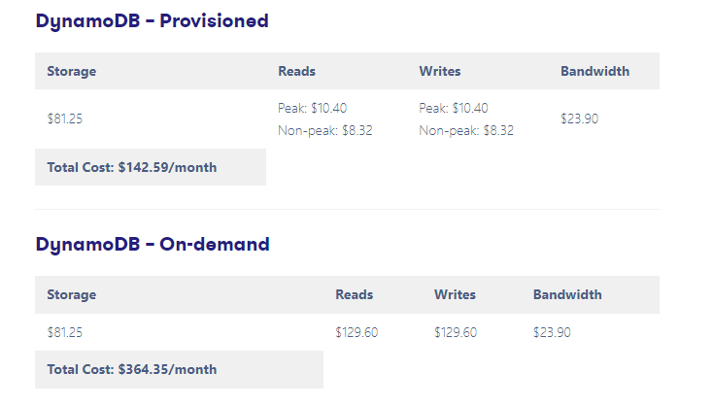

Slide 25
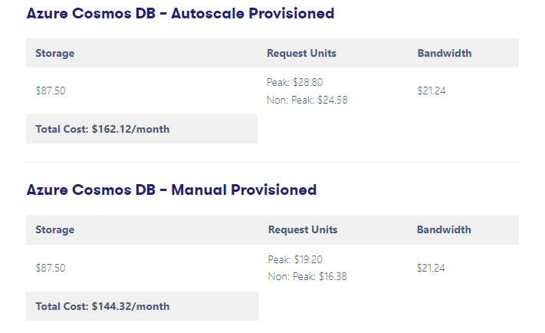

Slide 26
Consistency and Replication
Service | Consistency Options
AWS DynamoDB | -Eventually Consistent -Strongly Consistent
GCP Bigtable | -Eventually Consistent -Read-your-writes Consistent -Strongly Consistent
GCP Firestore in Datastore Mode | -Strongly Consistent
Azure Cosmos DB | Strong Bounded staleness Session Consistent prefix Eventual

Slide 27
When and Where to Pick Which Service
DynamoDB
DynamoDB is a perfect solution if you are looking for a cloud-based NoSQL database service. It is cost-effective and provides a variety of additional features.
Here are some of the most common use cases of DynamoDB:
If your application already uses other AWS services.
Applications that require uninterrupted performance at scaling.
Real-time streaming applications.
For scalable applications.
Shopping carts and gaming platforms.

Slide 28
When and Where to Pick Which Service
Cosmos DB
Cosmos DB is a better choice for any serverless application requiring milliseconds response times with high scalability. It natively and extensively supports multiple data models (key-value, documents, and graphs) and many APIs for data access, including Cosmos DB API for MongoDB, SQL API, Gremlin API, and Tables API.
Here are some of the most common use cases of Cosmos DB:
E-commerce platforms.
Simulating social interactions
Creating complex iOS and Android applications.
Gaming applications.
Internet of Things.

